Slide 1
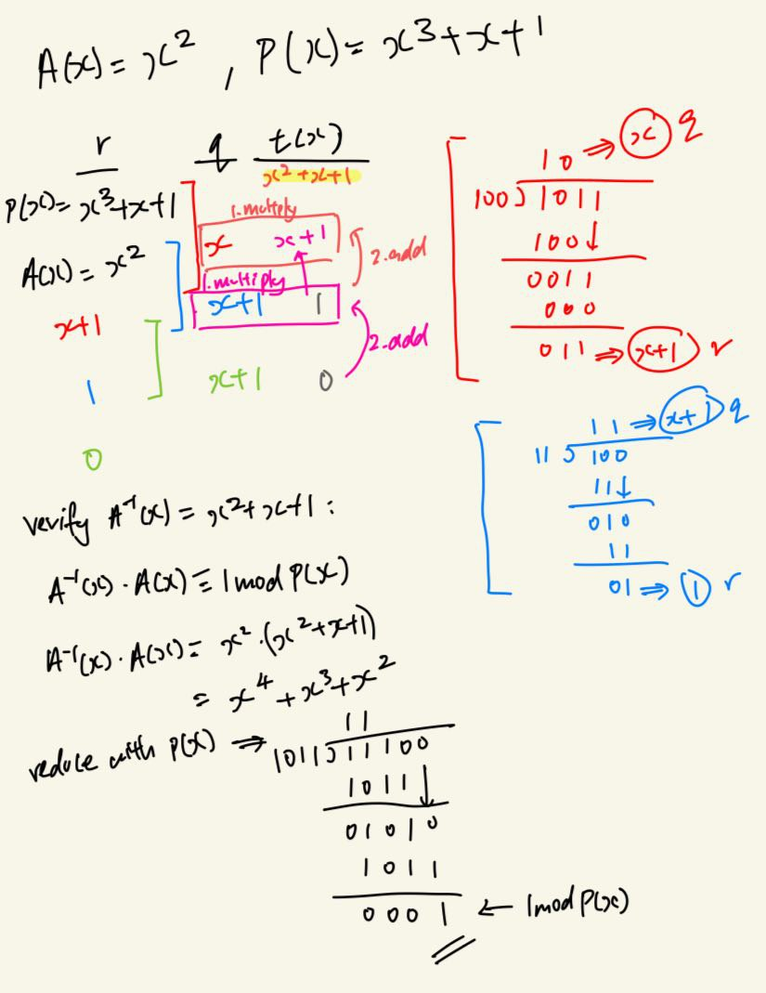
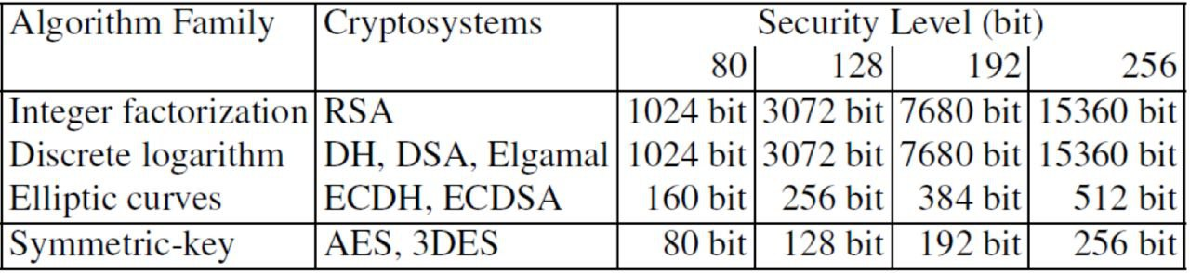
Modular Arithmetic
XOR: addition modulo 2 in GF(2)
AND: multiplication modulo 2 in GF(2)
Let a,r,m∈ ℤ, m>0, r is remainder, m is modulus
A ≡ r mod m, if m divides a-r
Infinitely many r, for any a & m
Closure:For all possible input values from the set, the output values are also an element of the set.
i.e: a○b=c ∈S ,for a,b,c ∈S
Associativity: The order of evaluation of operations doesn’t change the result of the expression.
i.e a○(b○c) = (a○b)○c for all a,b,c∈S
Identity:There is an identity element i∈S such that,
i○a =a○i for all a∈S
i.e for ‘+’ : i=0, for ‘x’ i=1
Invertibility:
For each element a∈S, the inverse a⁻¹∈S also exist.
a○a⁻¹=a⁻¹○a=i, where i∈S, i is identity element wrt ○
+ operator satisfy invertibility where a⁻¹= -a
x operator doesn’t satisfy invertibility
as there isn’t a⁻¹∈S for most a.
Group:G =(S,○) is a set of elements, S, and an operation ○ which combines 2 elements of S.
Properties: closed, associative, have identity element i, has inverse element a⁻¹ for all a∈S.
If G=(S,○) is commutative if a○b = b○a for all a,b∈S
e.g group of 3x3 matrix and matrix multiply operator is not commutative.
Order of finite group:
|G| is the number of elements in group G
i.e: for G =(ℤ_{m},+), |G| = | ℤ_{m}| = m
Order of element, a, in finite group:
ord(a) is the smallest +ve integer k s.t a^{k}=a○a○a...a=i
i.e order of 1 in G=({0,1,2},+) is 3 since 1+1+1≡0mod3
order of element 1 in G=(ℤ_{m},+) is m
Distributivity: for 2 different operators * and ○
if a*(b○c) = (a*b)○(a*c) for all a,b,c∈S
i.e x is distributive over +, + not distributive over x
Ring: Is a group (S,○,*) with 2 operators s.t:
is closed, * is associative, there exist i’∈S identity element, s.t i’*a=a*i’ for all a∈S, * is distributive over ○
Integer Rings:(ℤ_{m},+,•), ℤ_{m}= {0,1,...m} finite set.
a+b≡c mod m, c∈ℤ_{m} & a•b≡d mod m, d∈ℤ_{m}
Integer rings closed, + and x are associative, distributive.
Identity element 0 for +, for all a in ring there is -a, where a+(-a)≡0modm; additive inverse always exists.
Identity element 1 for •, for all a in ring a•i≡amodm
multiplicative inverse a⁻¹ exist for some elements.
if a⁻¹ exists, b/a≡b•a⁻¹modm,b∈ℤ_{m}. multiplicative inverse only exist if gcd(a,m)=1 i.e a & m are coprime.
Field: F=(S,+,•) has properties:
For all a∈S form an additive group with operation + and identity element 0.
For all a∈S, except 0, form multiplicative group with • and identity element 1.
When the 2 group operations are mixed, operation • is distributive over +.
Field ∈ Rings, not all fields are rings, as stricter requirements for fields.
All non-zero element of field must have a⁻¹ and multiplication operation must be commutative for field.
Galois Field: GF(q) Fields with a finite number of element a field of order m only exist if m is prime, i.e m=p^{n} for n>0 and prime integer p (characteristic of finite field).
This means there are finite fields with x^{n} element as long as x is prime. There are no fields with 36 elements, since 36 is not a prime power.
Prime Field: GF(p) is a Galois field with prime order, i.e. if n=1 GF(p) = GF(q).
2 operations, integer addition modulo p and integer multiplication modulo p.
If p is prime integer, integer ring ℤ_{p} is GF(P) and is a prime field. All non-zero element in GF(p) have inverse, arithmetic in GF(p) is done modulo p.
Extension Field: GF(p^{n}) where n>1, order is not prime
not all non-zero integers in GF(p^{n}) have inverse, cannot perform integer addition and multiplication modulo p^{n}. Need to represent elements as polynomials of degree n-1 for arithmetic.
+&-: bitwise XOR of coeffs (key addition in AES)
x&/: polynomial multiplication and reduction by fixed irreducible polynomial. AxB=C then ans=C/P(X).
inversion: extended Euclidean algorithm with the input polynomial, A(X) and irreducible polynomial, P(X).
Order of element x in ℤ*_{m}
Smallest k s.t x^{k}modm≡1modm Cyclic Groups: a group that contains an element 𝛂 that has maximum order, ord(𝛂) = |G|.
𝛂 is generator if every element in the group, a=𝛂^{k}, some +ve integer k. i.e 𝛂 can make every element
If p=m in ℤ*_{m=p} P is prime integer, (ℤ*_{p},•) is commutative finite cyclic group. i.e every prime group is cyclic and has ≥1 generator. ɸ(P) = p-1
Discrete Logarithm Problem: given a commutative finite cyclic group of ℤ*_{p} of order p-1, a generator 𝛂, and another element β∈ ℤ*_{p},the DLP is the trying to find an integer x, 1≤x≤p-1, s.t 𝛂^{x}≡βmodp. i.e trying to find x≡log_{𝛂}βmodp, x exist as 𝛂 is generator, but hard for large p.
One-way functions in cryptosystems:
y=f(x) is computationally easy
x=f⁻¹(y) is computationally infeasible
Diff from 1-way in hash, where the inverse doesn’t mathematically exist, e.g DLP, integer factorization.
DHKE: asymmetric (public-key) cryptoalgorithm
modular exponentiation ℤ*_{p}, where p is large prime integer is a one-way function and commutative.
i.e k=(a^{x})^{y}≡(a^{y})^{x}mod p, k is shared secret key
setup phase:
choose large prime p
choose generator 𝛂∈{2,3,...,p-2}
publish p and 𝛂 (for Alice and Bob to use)
key exchange: generate joint secret key k_{AB}
Alice pick private key, k_{pr,A}=a∈{2,3,...,p-2} and computes public key k_{pub,A}=A≡𝛂ªmodp, and send public key to Bob
Bob pick private key, k_{pr,B}=b∈{2,3,...,p-2} and compute publicc key k_{pub,B}=B≡𝛂^{b}modp, and send public key to Alice
They both compute joint secret key k_{AB}, Alice computes k_{AB}=(k_{pub,B})ªmodp and Bob computes k_{AB}=(k_{pub,A})^{b}modp, k_{AB}≡𝛂^{ab}mod p.
Oscar knows 𝛂,p, k_{A}and k_{b} but cannot compute k_{AB}
k_{AB} used by Alice and Bob for symmetric cipher.
Attack DHKE:
1. solve the DLP by finding value a s.t a≡log_{𝛂}Amod p
2. Then compute k_{AB}=Bªmod p
to defeat brute force search to find a, order of ℤ*_{p}=2⁸⁰
i.e p at least 80 bits long
other methods: shanks’s baby-step giant-step, pollard rho, pohlig-hellman, index-calculus (req p > 1024 bit)
asym need sig more bits than sym.
Square and multiply: works on x^{e}mod m, e.g 3⁵mod11
initialize result to x
scan bit of e from left to right (excl MSB)
if bit scan is ‘0’: sq curr result modm
if bit scan is ‘1’: sq curr result modm then multiply new result by x, modm
return final result
Asymmetric cryptography:
public key → encryption | private key → decryption
public key not used to encrypt plaintext, but encrypt shared secret key used in symmetric cipher,e.g AES.
RSA is used as key transport method.
Fermat’s Little Theorem: for element in prime field
a is an integer, p is prime number, a^{p}≡amod p
i.e a•a⁻²≡1mod p, a^{p-2} is multiplicative inverse of a
Euler’s Theorem: for elements in integer ring
a & m integers, are relatively prime, a^{ɸ(m)}≡1mod m
Egamal: make DHKE a cipher
Alice wants to send Bob a message x∈ ℤ*_{p}
After Alice and Bob calculate k_{AB}, Alice can encrypt plaintext by y≡x•k_{AB}modp, k_{AB}is multiplicative mask
Bob can decrypt by x≡y•k_{AB}⁻¹mod p, find k_{AB}⁻¹ using Fermet’s little theorem
RSA: uses integer factorization problem
Encryption & decryption performed in integer ring ℤ_{n}
since ℤ_{n} only contains {0,1,...,n-1}, binary value of both plaintext x and ciphertext y less than n
Modular exponentiation plays important role.
Key Generation phase:
Choose p & q ,2 large prime numbers
Compute n = p•q, n at least 1024 bit
Calculate ɸ(n) = (p-1)•(q-1)
Select public exponent e, s.t gcd(e,ɸ(n))=1, 1<e<ɸ(n)-1
Compute private key d, d=e⁻¹(modɸ(n))
Encryption/decryption phase:
plaintext x and k_{pub} = (n,e), encryption function is y=e_{k pub}(x)≡x^{e}mod n, where x,y∈ℤ_{n}
ciphertext y and k_{priv}= d, x=d_{k pr}(y)≡y^{d}mod n
Integer Factorization problem:
Multiplying 2 large prime numbers is easy, but given the product of 2 large prime numbers, it’s hard to factorize this product to obtain 2 prime numbers.
Choosing p & q: pick them randomly, then use fermat test or miller-rabin test to check primality
Computing k_{priv}: use Extend Euclidean Algorithm
Computationally intense: Encryption and decryption involve modular exponentiation, RSA 100-1000x slower than symmetric cipher like AES, hence RSA used to encrypt secret key.
Attack RSA: encryption is deterministic, specific pub key for particular plaintext, always mapped to a particular ciphertext. Oscar can transform ciphertext into another ciphertext that result in known transformation of original plaintext.
Protocol attack: exploit weakness of RSA (malleability), thwarted using padding
Mathematical attack: factorizing the modulo, n
then calculate private key d, d•e≡1modɸ(n), as he knows p,q and ɸ(n)=(p-1)•(q-1), d≡e⁻¹modɸ(n).
factorizing n is hard if n> 1024 bit
Side Channel attack: exploit information about private key leaked through timing behavior or power consumption
prevented using dummy operations of power masking
Digital Signatures:
Integrity: Attacker unable to modify the message transmitted without detection.
Authenticity: Message comes from legitimate source.
Non-repudiation: sender provided with proof of delivery, receiver provided proof of sender’s identity, no part can deny sending/receiving the message
Message Authentication Certificate (MAC)
Provide integrity & authenticity, not non-repudiation
(Recap) MAC uses shared secret key and hash function, compute authentication tag m, send m and x, receiver recomputes m’, check if m’==m.
RSA digital Signature protocol:
Select RSA parameters, p, q
Calculate n = p•q, ɸ(n) = (p-1)•(q-1)
Calculate k_{piv}, k_{pub} as per RSA, send k_{pub} to receiver.
Sender → sign plaintext x, s≡x^{d}modn, send (x, s)
Receiver → use k_{pub} to encrypt s, x’≡s^{e}modn, check x’≡xmodn
RSA digital Signature protocol:
Select RSA parameters, p, q, calculate n = p•q, ɸ(n) = (p-1)•(q-1)
Calculate k_{piv}, k_{pub} as per RSA, send k_{pub} to receiver.
Sender → sign plaintext x, S≡x^{d}modn, send x and S to receiver
Receiver → use k_{pub} to encrypt s, x’≡s^{e}modn, check x’≡xmodn=x
Proof of correctness: x’≡s^{e}≡(x^{d})^{e}≡xmodn
n usually 1024 to 3072 bits. use sq and mul for mod exponentiation.
use short k_{pub} to make signature verification fast, as x is signed once, but verified many times.
Attacking RSA signature:
Mathematical attack: factorizing mod n, defeat by make n>1024 bits
Existential forgery attack:
Attacker knows modulus (n) and pub exponent e in k_{pub}
Attacker choose some signature s, computes message x≡s^{e}modn
Attacker sends this fake x and s to receiver
Receiver verify signature is valid
Content of x can’t be controlled, prevent attack by only allowing certain valid formats for x. e.g pad 64 trailing ‘1’ bits.
Prevented by hashing the message, then signing the hash instead of the message. e.g RSA-PSS.
MITM DHKE:
Oscar intercepts k_{pub,A} & k_{pub,B} replace them with his k_{pub,O}
Alice computes k_{AO}, Bob computes k_{BO}, A & B unaware they are sharing a secret key with O, instead of each other
O can act as relay between A & B, if O receive cipher text from A, he can decrypt it using k_{AO}, modify, then re-encrypt with k_{BO}, then send to B.
Authenticated Channel vs Secure Channel:
Authenticated → Both party know the other party is legitimate
Secure → in addition to authenticated, provides confidentiality, message integrity.
Asymmetric Cryptosystem don’t need secure channel, but need authenticated channel for key distribution.
Certificate: create auth channel using digital signature, stop MITM
Certificate for k_{pub,A}: Cert_{A}=[(k_{pub,A},ID_{A}),sig_{k priv}(k_{pub,A},ID_{A})]
ID_{A} is some identifying info of Alice, e.g ip, signed with k_{priv} as it is mutually trusted 3rd party that signs cert, not Alice.
Certificate tie identity of user to their own k_{pub}
Certification Authorities (CA):
Provides 3rd party private key to sign certificate, also gens the cert.
Ensures Alice and Bob don’t need each other’s public key, they don’t have to send their pub keys over unauthenticated channel.
Certificate Generation:
With user-provided keys:
A computes her own pub-priv key pair, then request CA to sign her k_{pub,A} , A send her pub key to CA over auth channel.
With CA-generated keys:
A request CA to gen pub-priv key pair, sign the pub key. this request is sent over authenticated channel.
CA sends priv key to A over secure and authenticated channel.
DHKE with certificates:
A & B choose 𝛂 and p, generate their own pub-priv keys
A & B ask CA to sign their own pub keys, sign using RSA
A & B send their certs to each other (not their pub key)
A & B verify the certs are authentic using k_{pub,CA}
They extract their respective public keys from certs, use these pub keys for joint secret key.
To verify the certs, A & B require pub key of CA, transmitted through authenticated channel (need only once during setup)
Transfer of Trust: instead of A & B having to trust each other’s pub key, they only need to trust pub key of CA. When CA signs their pub keys, they know they can trust those pub keys too.
Public Key Infrastructure (PKI):
Not all users will have pub key of all CA installed in their OS, need PKI for CAs to certify each other, allow A to request for a cert of a CA she doesn’t have, this cert will be signed by CA A alr has.
CA chaining:
A only has pub key of CA1, B only has pub key of CA2.
A need B’s pub key for DHKE
B send A his cert with pub key signed by CA2
A cannot verify the cert as she doesnt have pub key of CA2
A req CA2 to send her CA2 pub key
CA2 send A its pub key, signed by CA1
A verify CA2 cert, use its pub key to verify B’s pub key.
Key establishment:
Provide confidentiality and integrity
DHKE & RSA establish keys over insecure, but authenticated channel (digital signature and certs), prevent Man in the Middle
2 main groups: key transport | key agreement
transport: 1 side gen & distribute secret key: RSA
agreement: both side gen a secret key tgt: DHKE
Euler’s phi: number of integers in set ℤ_{m} that are relatively prime to m = ɸ(m), gcd(j,m)=1.
Large m: calc ɸ(m) extremely slow.
If we know the factorization of m, much faster way to calc ɸ(m). critical to RSA
Calculating ɸ(m) = ∏^{n}_{j=1}(p_{j}^{ej}-p_{j}^{ej-1}), p_{j} are distinct primes, e_{j} are +ve integers.
e.g if m=240=2⁴•3•5,ɸ(240)=(2⁴-2³)•(3¹-3⁰)•(5¹-5⁰)=64
Finite group ℤ*_{m} consist of all integers from 1 to m-1 which gcd(j,m)=1, ℤ*_{m} forms commutative group under multiplication modulo m, i =1, ord(ℤ*_{m}) = ɸ(m)
e.g 3⁵mod11
initialize result =3
5₁₀=101₂, 3 bit, hence 3-1=2 iterations
1st iter: bit =‘0’, 3²mod11=9mod11
2nd iter: bit =‘1’
9²mod11=81mod11=4mod11
4•3mod11=12mod11=1mod11
3⁵mod11 ≡1mod11

Slide 2
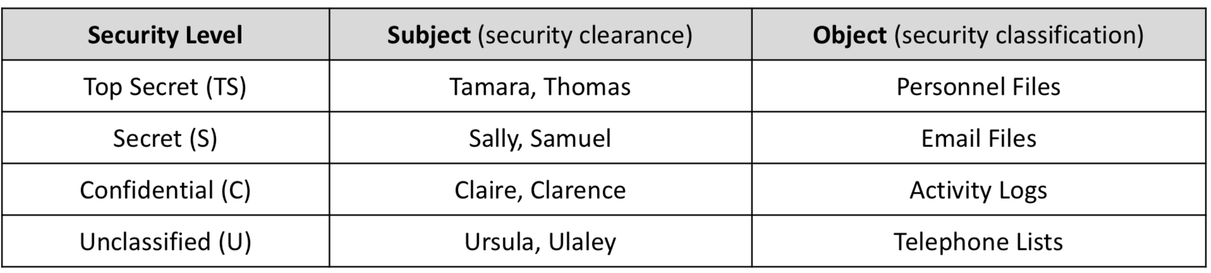
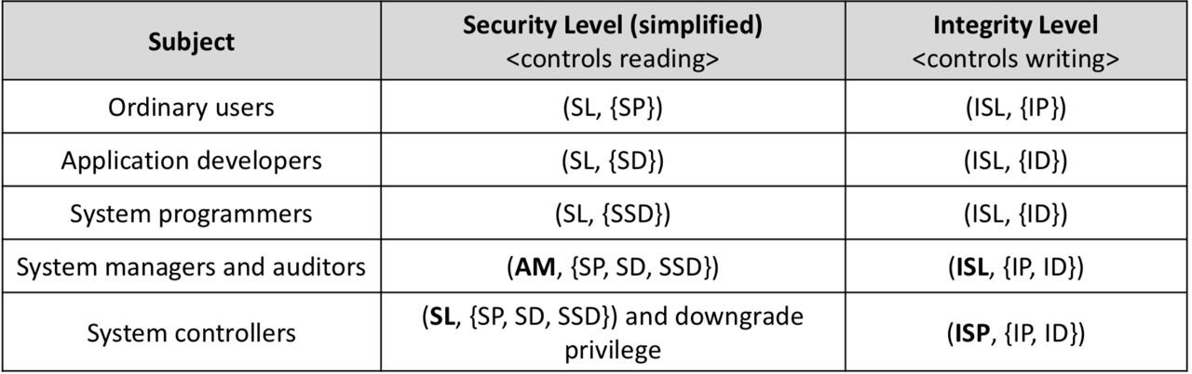
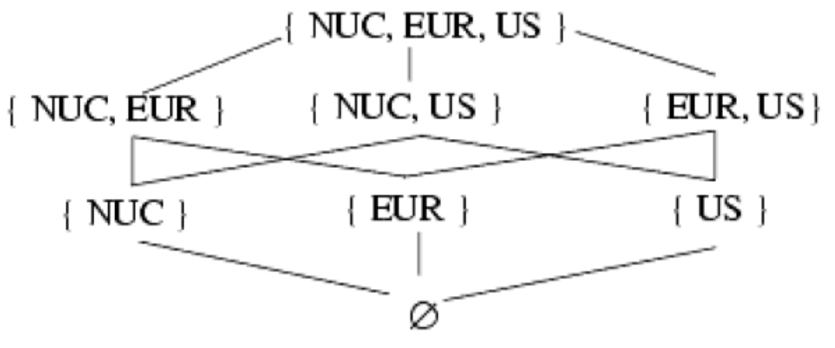
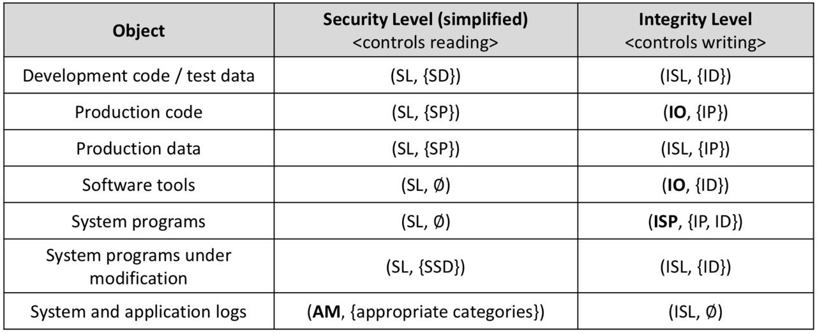
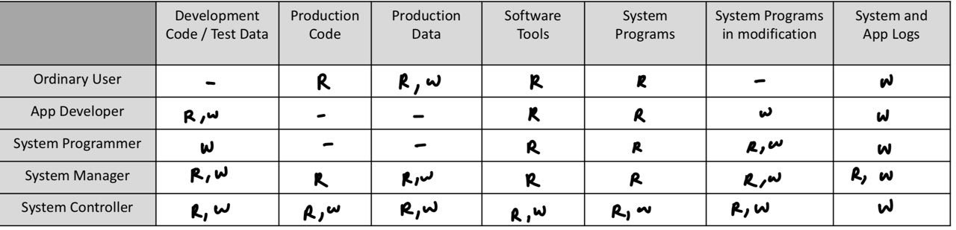
X.509 certificates:
Solutions to problem with pipelining:
Stall pipeline until result of BEQ is known (slow)
Do speculative execution, guess outcome of BEQ, fetch the instr to execute speculatively.
After outcome of BEQ is known:
- if correct, CPU proceeds
- if wrong, CPU squash all wrong instructions, rewind reg state, fetch correct instruction, then continue
Speculative execution:
Require CPU to guess the outcome of a branch instruction using branch prediction
Branch predictor approach:
Always take/ always not take branch
Branch predictor circuit
Simple Branch predictor:
2 bit saturating counter- moore FSM with 4 states
input: “branchOutcome” | output: “branchPredict”
input connected to CPU control unit, if actual outcome of BEQ is branch is taken, branchOutcome set to 1, else set to 0
output connected to CPU control unit, if branchPredict set to 1, Control unit fetches instruction at branch target, if branchPredict 0, CU fetch next inst PC+4
Spectre Attack:
Prime the branch predictor of the CPU by running code snippet few times with input ”x” to ”train” predictor to predict the “if” will result to ”true”.
Now intentionally input x > array1_size
As array1_size not in cache, cache miss, CPU need time to retrieve this from mem.
Since branch predictor primed to return “true”, it runs the code anyway, and read value at array1[x], returning value k, smwhr in cache
since k is in cache, it returns faster than array1_size from memory.
CPU now speculatively request for integer located at array2[k*4096]
Since no elements in array2 are cached, only block with array2[k*4096] brought into cache
Now, outcome of BEQ determined, CPU realized it was wrong
CPU squash all wrong instruction and revert register states, but cache state is unchanged
Attacker still doesn’t know value of k
Now he sequentially requests data for array2[i*4096], for i =0,1,2... and measure time taken for each mem read. when i=k, time taken for the mem read is much shorter as k is in cache, now Attacker knows k.
Type of security policy:
Military: primarily provide confidentiality, secret
Commercial: primarily provide integrity, tamper proof
Confidentiality: dealing only with confidentiality
Integrity: dealing only with integrity
Security policy language: express security policies (policy constraints) in precise way
High-level: constraints expressed in abstract manner, ignores implementation issues
ISO27000 Definition of confidentiality: The property, that information is not made available or disclosed to unauthorized individuals, entities or processes.
X is set of all entities, I is some information. I is confidential wrt X if no x∈X can obtain info from I.
Program (low-level policy language):
Program: a function with multiple inputs and 1 output
R is set of outputs that are non-erroneous
E is set of outputs that indicate errors
eg. mechanism ask for user & pw. input: user, pw
R (non-erronous output): Success/Fial
if user is in illegal format, output error
Every legal input to m produce either same result as p or an error message.
Confidentiality policy: prevent unauthorized disclosure of information.
c(i,j,k) = (i,j) is a policy that indicates i and j can be disclosed but k is confidential
Bell-LaPadula model:
specifies confidentiality policies
military style classification
significant influence in computer security
Step 1: security level (highest to lowest)
Top Secret, Secret, Confidential, Unclassified
Subject (s) has security clearance L(s)
Object (o) has security classification L(o)
Bell-LaPadula model – reading information:
Information flows up, not down, ”no reads up"
Subject s can read object o if L(o) ≤ L(s).
Bell-LaPadula model – writing information:
”Writes up” allowed, “Writes down” not allowed
Subject s can write object o if L(S) ≤ L(o).
This ensures no information of higher sensitivity is maliciously/ accidentally leaked to lower levels
Step 2: extension to categories
Security level: (clearance, category set)
e.g (Top Secret, {NUC,EUR,US})
(L,C) dom (L’,C’) if and only if L’≤ L and C’ ⊆ C
Reading information: ”no reads up”
Subject s can read object o if L(s) dom L(o)
Write information: “no write down”
Subject s can write object o if L(o) dom L(s)
Integrity policy: prevents unauthed mod of data
influenced by commercial requirements:
Users use existing production programs and db
Programmers will dev and test programs on non-production system
Special process to install program from dev system to production system, controlled and audited
auditor and manager have access to both system state and logs that are generated.
Integrity Model:
Set S of subjects, O of object, I of integrity levels
relation ≤ ⊆ I x I hold when 2nd integrity level dom 1st
min: I x I → I gives lesser of the 2 integrity levels
i: S U O → I returns integrity level of subject or object
r ⊆ S x O defines ability of subject to read object
w ⊆ S x O defines ability of subject to write object
x ⊆ S x S defines ability of subject to invoke (or execute) another subject.
Integrity level:
Higher integrity level → more confidence that a program will execute correctly, data is accurate/ reliable
Integrity level vs Security level:
Security level: limit flow of information
Integrity level: restrict modification of information
Use trustworthiness to measure integrity level:
High trust, Medium trust, Low trust
Low-Water-Mark policy:
if s ∈ S reads o ∈ O, then i’(s) = min(i(s),i(o)), where i’(s) is the subject’s integrity level after read, prevent less trusted object from contaminating subject
s ∈ S can write to o ∈ O if and only if i(o)≤i(s), prevent subject from writing to more trusted object
s₁∈S can execute s₂∈S if and only if i(s₂)≤i(s₁) prevent less trusted invoker from controlling execution of the invoked subject, corrupt the invoked subject even though its more trustworthy
Problem with Low-Water-Mark:
s integrity lowered when s reads from low-integrity o
As time pass, no s will be able to access high integrity lvl
This policy prevents indirect modification.
Ring policy: keep subject’s integrity level static
1. Any s ∈ S can read any o ∈ O
2. s ∈ S can write to o ∈ O if and only if i(o)≤i(s)
3. s₁ ∈ S can execute s₂ if and only if i(s₂)≤i(s₁)
Eliminates indirect modification problem.
Strict integrity model (Biba model): opp to BLP
1. s ∈ S can read o ∈ O if and only if i(s)≤i(o), no reads down
2. s ∈ S can write to o ∈ O if and only if i(o)≤i(s), no write up
3. s₁ ∈ S can execute s₂ if and only if i(s₂)≤i(s₁)
BLP for commercial purpose:
2 security clearances: (higher to lower)
- AM (audit mnger): system audit, management functions
- SL (system Low): any process can read at this level
5 security categories:
- D (development): production program in dev not in use
- PC (Production Code): production processes and prog
- PD (Production Data): data covered by integrity policy
- SD (System Development): system programs in dev but not yet in use
- T (Software Tools): progs in production system not related to protected data
BLP principles:
Ordinary users can execute & read production code but cannot alter it
Ordinary users can alter and read production data
Sys managers require access to all logs buy cannot change the security level of objects
Sys controllers require ability to install code, these users will be given downgrade capabilities (ability to move object from dev to production)
Logs can only be append to (not overwritten), logs must dom any subject that is writing to them
BLP object & security level:
Problem with BLP:
Too inflexible, sys manager cannot run prog for repairing inconsistent or erroneous prod db, sys man have AM clearance, but production data has SL security lvl, sys man cannot write production data
complicated security categories, 5 is too many
Lipner’s model: combine BLP and Biba
implement BLP component first to control reading
implement Biba component to control writing
simplify security categories in BLP
Simplified BLP:
Reduce categories to 3:
SP (production): production code and data (combine previous ‘PC’ and ‘PD’ categories)
SD (development): same as previous ’D’ category
SSD (System development): same as previous ‘SD’
Retain 2 security clearance level: AM and SL
Adding integrity level to BLP security model:
3 integrity classification (highest to lowest):
ISP (system prog): for sys programs
IO (operational): for production programs & dev software
ISL (System Low): users get this classification on login
2 integrity categories:
ID (development): development entities
IP (production): production entities
No reads up (security) + No writes up (integrity) enforced
Simplified BLP subject and level:
Simplified BLP Object and level:
Step 1. check for clearance lvl:
read: AM > SL, check for write: ISP>IO>ISL
Step 2. check for category:
check if object categories are subset of subject categories
Serial number
Certificate Algorithm -Algorithm -Parameters
Issuer
Period of validity -Not before date -Not after date
Subject
Subject’s Public Key: -Algorithm -Parameters -Public Key
Signature
Object | Security level
Dev Code/ Test data | (SL, {D,T})
Production code | (SL, {PC})
Production Data | (SL,{PC,PD})
Software tools | (SL,{T})
System programs | (SL, ∅)
System prog under mod | (SL, {SD,T})
System & app logs | (AM, {appropriate category})
the cryptoalgorithm used to sign the cert, e.g RSA
not certified indefinitely, to limit amount of dmg if priv key is compromised
this is the pub key protected by the cert. algorithm used in pub key maybe not same as the one used in cert itself.
Side Channel Attacks
Any attack based on extra information that can be gathered based on the fundamental way a cryptoalgorithm is implemented.
e.g timing information, power consumption, electromagnetic leak, sound.
Skimming attack: magnetic stripe of ATM cards
Magnetic stripe store card details, copy the details.
Prevented using embedded microchip performs secure transactions using 3DES & RSA.
Attack smart key systems: Relay attack
Attacker can clone the smart key, then use antenna relays to extend the range of the key from 5m to >100m, increase likelihood of locating victim’s car.
Preventions: distance bounding protocol
when smart key and vehicle are exchanging message, record timing of the message, calculate distance between between key and car.
drawback: timing precise (ns scale), clock of car and key need to be synced
Other side channel attacks on wireless:
Jamming (DOS), radio fingerprinting, Attacks on wifi based localization (RSSI).
Other side channel attacks:
Power monitoring attack, cache-based spectre attack, timing attack, electromagnetic attack, audio side-channel, optical side-channel.
Power monitoring attack:
Attacker monitors power consumption of the smart card using digital oscilloscope, when card is doing some algorithm, can observe the private key based on high/low power to identify each bit.
Prevention: power masking / execute dummy computations. the computation does nothing but looks like some operation in the oscilloscope.
Cached-based attack (Spectre):
Single-cycle CPU→all inst take 1 clock to complete.
Issues with single cycle CPU:
all inst take as long as slowest inst, slow clock speed.
adding instr tat req more logic gates, slower clock spd
all parts of dataparth (regfile, ALU) idle while waiting for instructions to complete.
Pipelined datapath: Split datapath into many smaller stage, each stage do a simple task.
Reduces logic gates in each stage, faster clock
Use register to store state of inst btwn stages
overlap the processing of several instr at 1 time, better utilization of gates.
CIA triad:
Confidentiality: attacker unable to decipher any secret data being transmitted between legitimate parties.
Integrity: attacker unable to modify data being transmitted between legitimate parties without being detected
Availability: services provided by some party are resilient against interruptions caused by attackers
Security policy: statement of what is & is not allowed
A type of system requirement, or refinement of more abstract properties.
Security mechanism: method, tool or procedure to enforce a security policy. 3 main classes:
Prevention, Detection, Recovery
Security model: model that represents particular set of security policies.
Access Control: used alone or in combination
Discretionary Access control (DAC): individual user sets access control mechanism to allow or deny access to an object, blog owner decide who can r&w.
Mandatory Access control (MAC): system mechanism controls access to object and the individual cannot alter that access, police can intercept suspect phone
Subject | Security level
ordinary users | (SL, {PC,PD})
Application dev | (SL, {D,T})
System programmer | (SL,{SD,T})
System manager & auditor | (AM, {D,PC,PD,SD,T})
System controller | (SL, {D,PC,PD,SD,T}) + downgrade priviledge

Slide 3
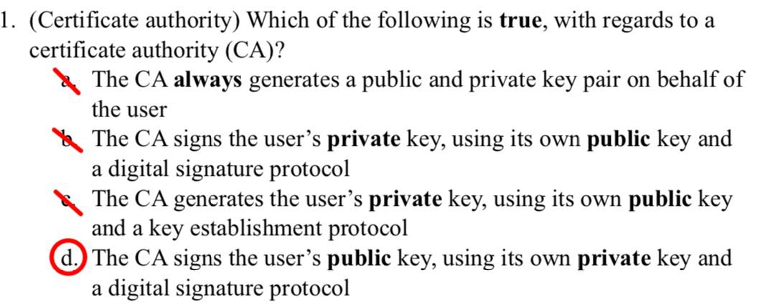
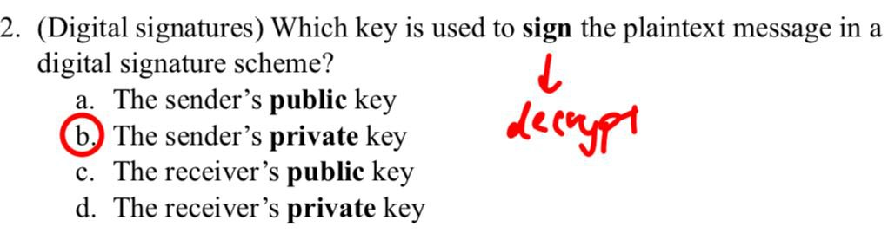
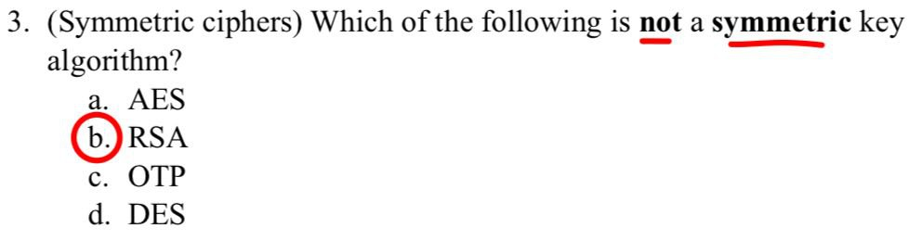
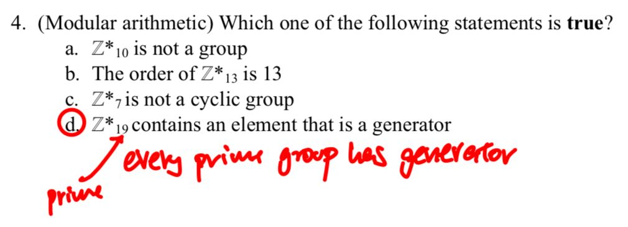
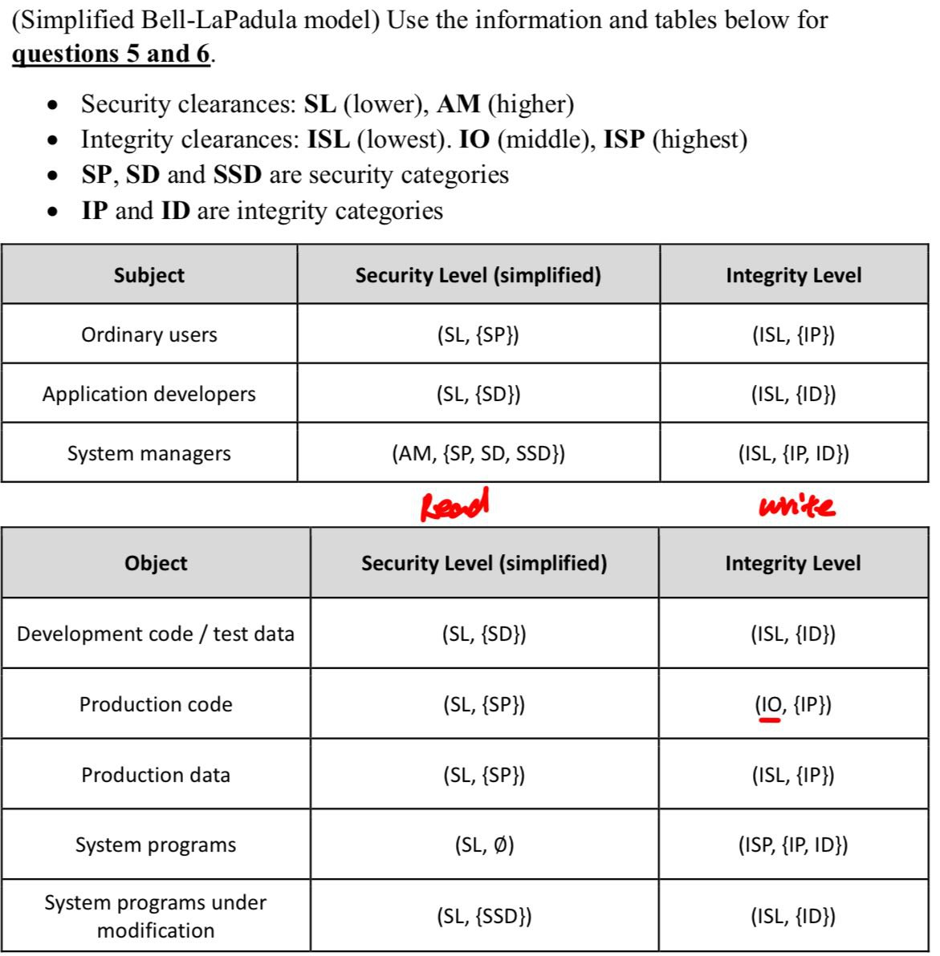
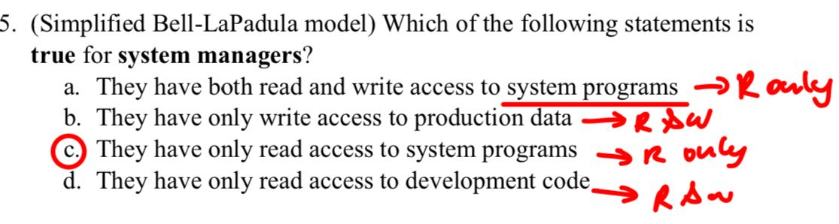
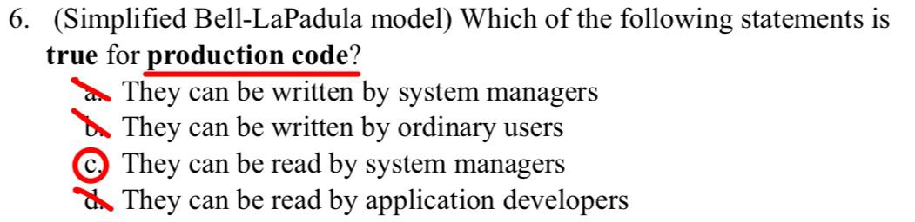
Information flow models:
access control constrains the rights of the user but can’t constraint the flow of information about the system.
Information flow models and information flow policies abstract the essence of security policies.
Information flow policy: Defines how info moves through system.
Prevent info from flowing to user who’s not authed (confidentiality)
info to process that are not more trustworthy than the data (integrity)
Basic idea: system is secure if groups of subjects cannot interfere with one another.
System is not secure if it can enter an unauthorized state from authorized state.
Information flow model:
consist of: Subjects: S={s_{i}}, States: ∑ = {σ_{i}}, Outputs: O={o_{i}}, Commands: Z = {z_{i}}, State transition commands C = S x Z
inputs select the commands to execute, or inputs themselves encoded in set of state transitions.
State transition function T: C x ∑ →∑
Executing state transition command c when in state σ₀ → state σ₁
Let C* be set of possible sequences of state transition commands in C, then function T*: C* x ∑ →∑ and c* =c₀,...,c_{n}
T*(c*,σ_{i}) = T(c_{n},T(c_{n-1},...,T(c₀,σ_{i})...))=σ_{i+n+1}
Output function P: C x ∑ → O
Output of the FSM when execute state transition command c in state σ
Let O* be set of possible sequences of outputs after executing some sequence c* ∈ C*, then P*: C* x ∑ → O* and c* = c₀,...,c_{n}
P*(c*,σ_{i})=o_{i+1},o_{i+2},...,o_{i+n},o_{i+n+1}
Projection: proj(s,c*,σ_{i}) is the sequence of outputs in P*(c*,σ_{i}) that subject s is authorized to see, i.e proj function removes outputs that s is not supposed to see.
Purge: 𝞹_{i,j} (c*): subseq c* with all elements (s,z), s ∈ i and z ∈ j deleted
deleted means element is removed from observable sequence.
Non-interference: set of output Lucy observe corresponds to the set of commands that she can observe. proj(s,c*,σ_{i}) =proj(s,𝞹_{G,A}(c*),σ_{i})
System is secure wrt subjects in G’ & commands in A, if any only if every subject in G is non-interfering with all subjects in G’.
G’ cannot deduce info about subject in G, but G can deduce info about subject in G’.
Example: σ₀=(0,1), c* = (Holly, xor0), (Lucy, xor1), (Holly, xor1), P*(c*,σ₀) = 01,10,01
let G ={Holly}, G’ = {Lucy}, A=Z={xor0,xor1}
Purge Holly: 𝞹_{Holly,A}(c*)=(Lucy,xor1), proj(Lucy,c*,σ₀)=1,0,1
proj(Lucy,𝞹_{Holly,A}(c*),σ₀)=proj(Lucy,(Lucy,xor1),σ₀)=0
proj(Lucy,c*,σ₀)≠proj(Lucy,𝞹_{Holly,A}(c*),σ₀)
{xor0,xor1}, {Holly} :| {Lucy} is false, Holly interfering with Lucy as commands to change H bit changes the L bit also.
Even though Lucy should not be aware of Holly’s existence, Lucy can tell that there is some other user, bases solely on the observation of her own output sequence.
Conditional Entropy:
Conditional entropy of X given Y=y_{i} , outcome of Y is known
H(X | Y =y_{i}) = -∑^{n}_{i=1}P(X=x_{i} | Y=y_{i})•log₂P(X=x_{i} | Y=y_{i})
Conditional entropy of X given Y, outcome of Y is unknown
H(X | Y) = -∑^{m}_{i=1}P(Y=y_{i})•∑^{n}_{i=1}P(X=x_{i} | Y=y_{i})•log₂P(X=x_{i} | Y=y_{i})
Entropy and information flow:
Information flows X → Y if execution of sequence of commands c* cause information initially in X to affect information in Y.
c* are set of commands to change from state a to state b
if H(X_{a} | Y_{b}) < H(X_{a} | Y_{a}), flow of info form X to Y.
H(X_{a} | Y_{b}) more predictable now as more info in Y_{b} that came from X
if Y_{b} doesn’t exist in state a
if H(X_{a} | Y_{b}) < H(X_{a}), flow of info from X to Y
important note: log₂0=0
Baye’s theorem: P(Y | X) = P(X | Y)•P(Y)/P(X)
Implicit flow of information: flows of information from X to Y without explicit assignment of y=f(x), e.g if x ==1 then y =0, else y=1
Notation for security class:
X: security class of X, defined in Bell-LaPadula based system
X ≤ Y: info allowed to flow from element in security class of X to ~ in Y
Compiler-based mechanism:
Detects and block unauthorized flow of info in a program during compilation, wrt given security policy. Analysis conducted by mechanism is not precise, but secure.
Not precise: path of info flow marked unauthorized, but should be authorized, i.e it is false positive
Secure: No unauthorized path of info flow will remain undetected
Certified: Set of statements is certified with respect to an information flow security policy if the information flow within that set of statements does not violate the security policy.
Example: if x ==1 then y := m, else y := n.
There is info flow from X and m to y, info flow from X and n to y.
If the security policy states: X≤Y and M≤Y and N≤Y, certified
Array:
... := m[i]; # nformation flowing out
i and M[i] affect the var assigned, security class of array is max(I,M[i])
m[i] := ... #information flowing in
only variable m[i] is affected, security class for the array is m[i].
Assignment statement:
x := y+z
Info flow from Y & Z to X, certified if security policy states max(Y,Z) ≤ X
G: statement y:= f(x₁,...,x_{n}), security policy must state max(X₁,...,X_{n})≤Y
Compound statement:
statement 1: x := y+z;
statement 1 certified if sec policy states max(Y,Z)≤X
statement 2: m := n*o-x;
statement 2 certified if security policy states max(N,O,X)≤M
entire code to be certified, sec policy is max(Y,Z)≤X and max(N,O,X)≤M
G: <s_1>;...<s_n>; certify each statement with security policy
Conditional statement:
if x + y < z then m := n, else p := n * o – x;
security policy: N≤M and max(N,O,X)≤P
info about x,y,z revealed in conditional step, since they are part of the condition, security policy also must have max(X,Y,Z) ≤ min(M,P)
G: if f(x₁,...,x_{n}) then <s_1> else <s_2>, certify <s_1> & <s_2> and max(X₁,...,X_{n})≤min(Y|Y is target of assignment in <s_1>, <s_2>)
Iterative statement:
while f(x₁,...,x_{n}) do
<s_1>
end
G: check loop terminates eventually, certify <s_1>,
max(X₁,...,X_{n})≤ min(Y | Y is target of assignment in <s_1>)
Infinite loops:
Compiler-based mech cant detect if loop will terminate at compile time.
Use execution-based mech (dynamic), check info flow at run time
Execution based mechanism: dynamic in nature
Stops any info flow that violate security policy.
Before y := f(x₁,...,x_{n}); executed, execution-based mech verify max(X₁,...,X_{n})≤Y. Block if verification fails.
Easily checks for explicit flow of information, hard to check implicit flow
Probability concepts:
X is a discrete random variable, has some probability of taking one of the values x₁,x₂,...,x_{n}.
∑^{n}_{i=1}P(X=x_{i})=1, sum of probability of all outcome =1
E(X) = ∑^{n}_{i=1}P(X=x_{i})•x_{i},
Information of a particular outcome: I_{X}(x_{i}) or I(X=x_{i})
Measure amount of info received in bits, when outcome of X is x
I(X=x_{i}) = log₂(1 / (P(X=x_{i}))
Amount of info received by learning the outcome of X is x_{i} is inversely proportional to the probability of x_{i} occurring.
Example: if P(X=1) =0.5, P(X=0) =0.5, I(X=1)=log₂(1/0.5)=log₂2=1
Gain 1 bit of information by learning the outcome of X is 1
Entropy of discrete random variable: H(X)
Measures the uncertainty of X, in bits.
H(X) is the expectation of information of X
H(X) = ∑^{n}_{i=1}P(X=x_{i})•I(X=x_{i}) = ∑^{n}_{i=1}P(X=x_{i})•log₂(1/P(X=x_{i}))
H(X) = -∑^{n}_{i=1}P(X=x_{i})•log₂P(X=x_{i})
Example: H(X) = -(0.5)•(log₂0.5)-0.5•log₂0.5=1
Entropy of variable is inversely proportional to its predictability, lower entropy → more predictable
H(X) = 0, completely predictable
H(X) = ∞, completely unpredictable
if H(X’) < H(X), X’ more predictable than X
we know more about X’ than X

Slide 4
